Slide 1





Pitt Business Analytics Case Competition
Ziyad Banadqaji
Jacob Gossett
Meet Patel
Alex Medearis

Slide 2
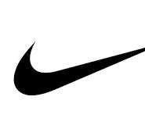




The Challenge
Determining the Footwear Brand to be Featured on DICK'S Sporting Goods Premium Footwear Deck in the new House of Sport in Pittsburgh

Slide 3
Recommendation
Higher projected brick & mortar sales over next 5 years than On Running & Adidas
Greater focus on B&M with lowest eCommerce penetration
Reduced risk with a strong parent company in Deckers
Future partnership potential

Slide 4
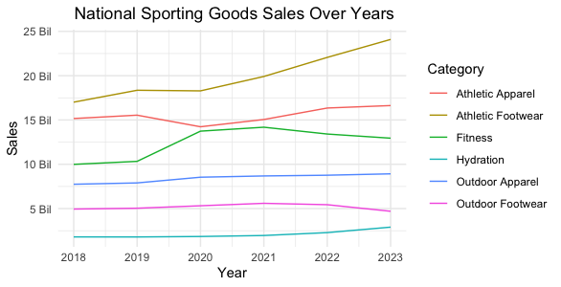
Analysis: National Sporting Goods Market
Rapid growth ..
Athletic footwear has the highest sales and the maximum year-over-year growth rate compared to other categories.
The athletic footwear category did not experience a significant negative impact due to COVID-19.
Expected 2.9% annual growth rate until 2028

Slide 5
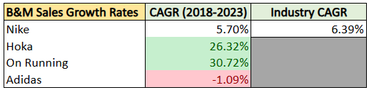
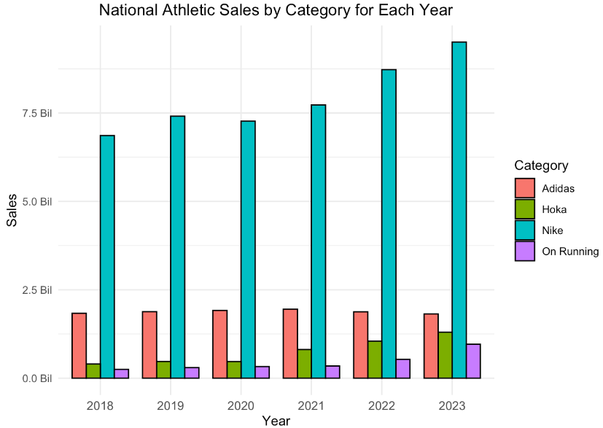
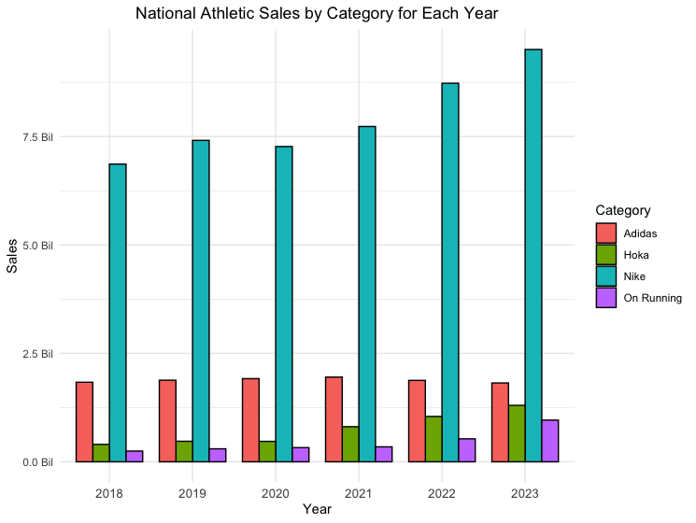
Analysis: National Athletic Footwear
Nike - highest sales volume, but high concentration & growth in eCommerce
On Running - highest CAGR for B&M sales, but lowest B&M market share, increasing eCommerce penetration, and just went public in 2021
Adidas - second in sales volume and lowest in eCommerce sales, but sales are trending in the wrong direction and eCommerce penetration is very high
Hoka - rapid growth with their B&M sales projected to exceed Adidas this year, as well as lowest eCommerce penetration

Slide 6
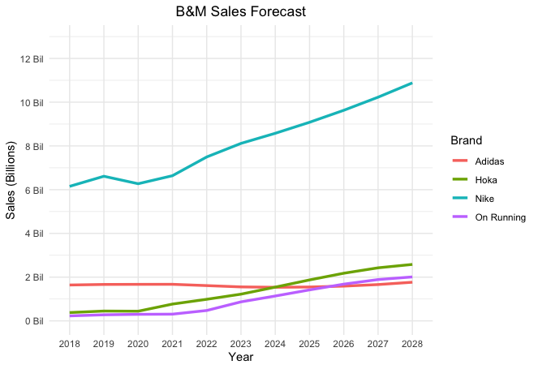
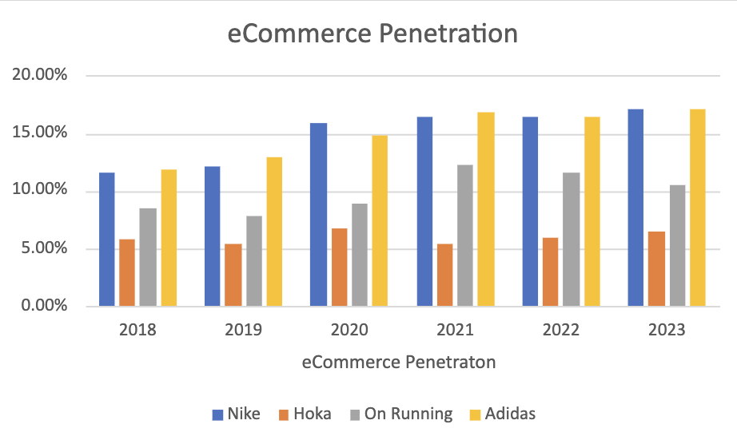
Sales Forecast & eCommerce Penetration
Forecast assumes that each company grows by their recent CAGR in 2024 and progressively approaches the athletic footwear industry CAGR by 2028.

Slide 7
Opportunities with Hoka
Potential Long-Term Partnership
Become Hoka's Main Distributor
Could strongly encounter increase in sales with more visits in the new House of Sport
Only 18 Hoka's owned stores out of 3063 sales distribution points
Exclusive Products Launches, Exchange Expertise, Marketing Campaigns, and In-Store Events
Increase Average Transaction Amount
Provide Wide Variety of Assortments and Products
Support DICK's Mission of Inspiring Athletes and Delivering Shareholder Value via Growth

Slide 8
Implementation Plan
Select best-selling Hoka shoes to be featured on the premium deck
Assign/train workers dedicated to Hoka's special footwear
Ensure enough supply of each footwear via inventory optimization
Measure Key Performance Indicators (KPIs) frequently to thrive for evaluation & improvements
Ex. Footwear sales, stock keeping unit turnover, etc.

Slide 9
Risk Mitigation
Higher prices causing sales to decline
Promise high quality not low prices
Utilize Promotions, Advertisements, and Marketing Campaigns
Customers dissatisfaction after purchase
Offer after-sale service for returns, exchanges, and other assistance
Seek feedback to improve in the future
Competing with the giant industry leader Nike and other growing brands
Continue selling other brands to account for any variability in sales
Having Nike as a great alternative in case things do not go well with Hoka
Continues evaluation of brands and market performance

Slide 10
Appendix
https://www.statista.com/outlook/cmo/footwear/athletic-footwear/united-states
https://www.cbsnews.com/pittsburgh/news/dicks-sporting-goods-house-of-sport-to-open-at-ross-park-mall-in-2024/
https://www.scrapehero.com/location-reports/Hoka%20One%20One-USA/#:~:text=There%20are%203%2C072%20Hoka%20One,One%20stores%20in%20the%20US.
https://www.statista.com/forecasts/1351932/nike-sneakers-brand-profile-in-the-united-states
https://www.reuters.com/business/retail-consumer/retailers-slash-prices-more-nike-sneakers-2024-data-shows-2024-02-02/
https://d18rn0p25nwr6d.cloudfront.net/CIK-0000910521/621a4da9-bfc5-4b90-8a5c-82196890e9e9.pdf
https://d18rn0p25nwr6d.cloudfront.net/CIK-0000910521/39cc2761-e3d7-4560-97a9-a83d050ec82b.pdf

